Slide 1

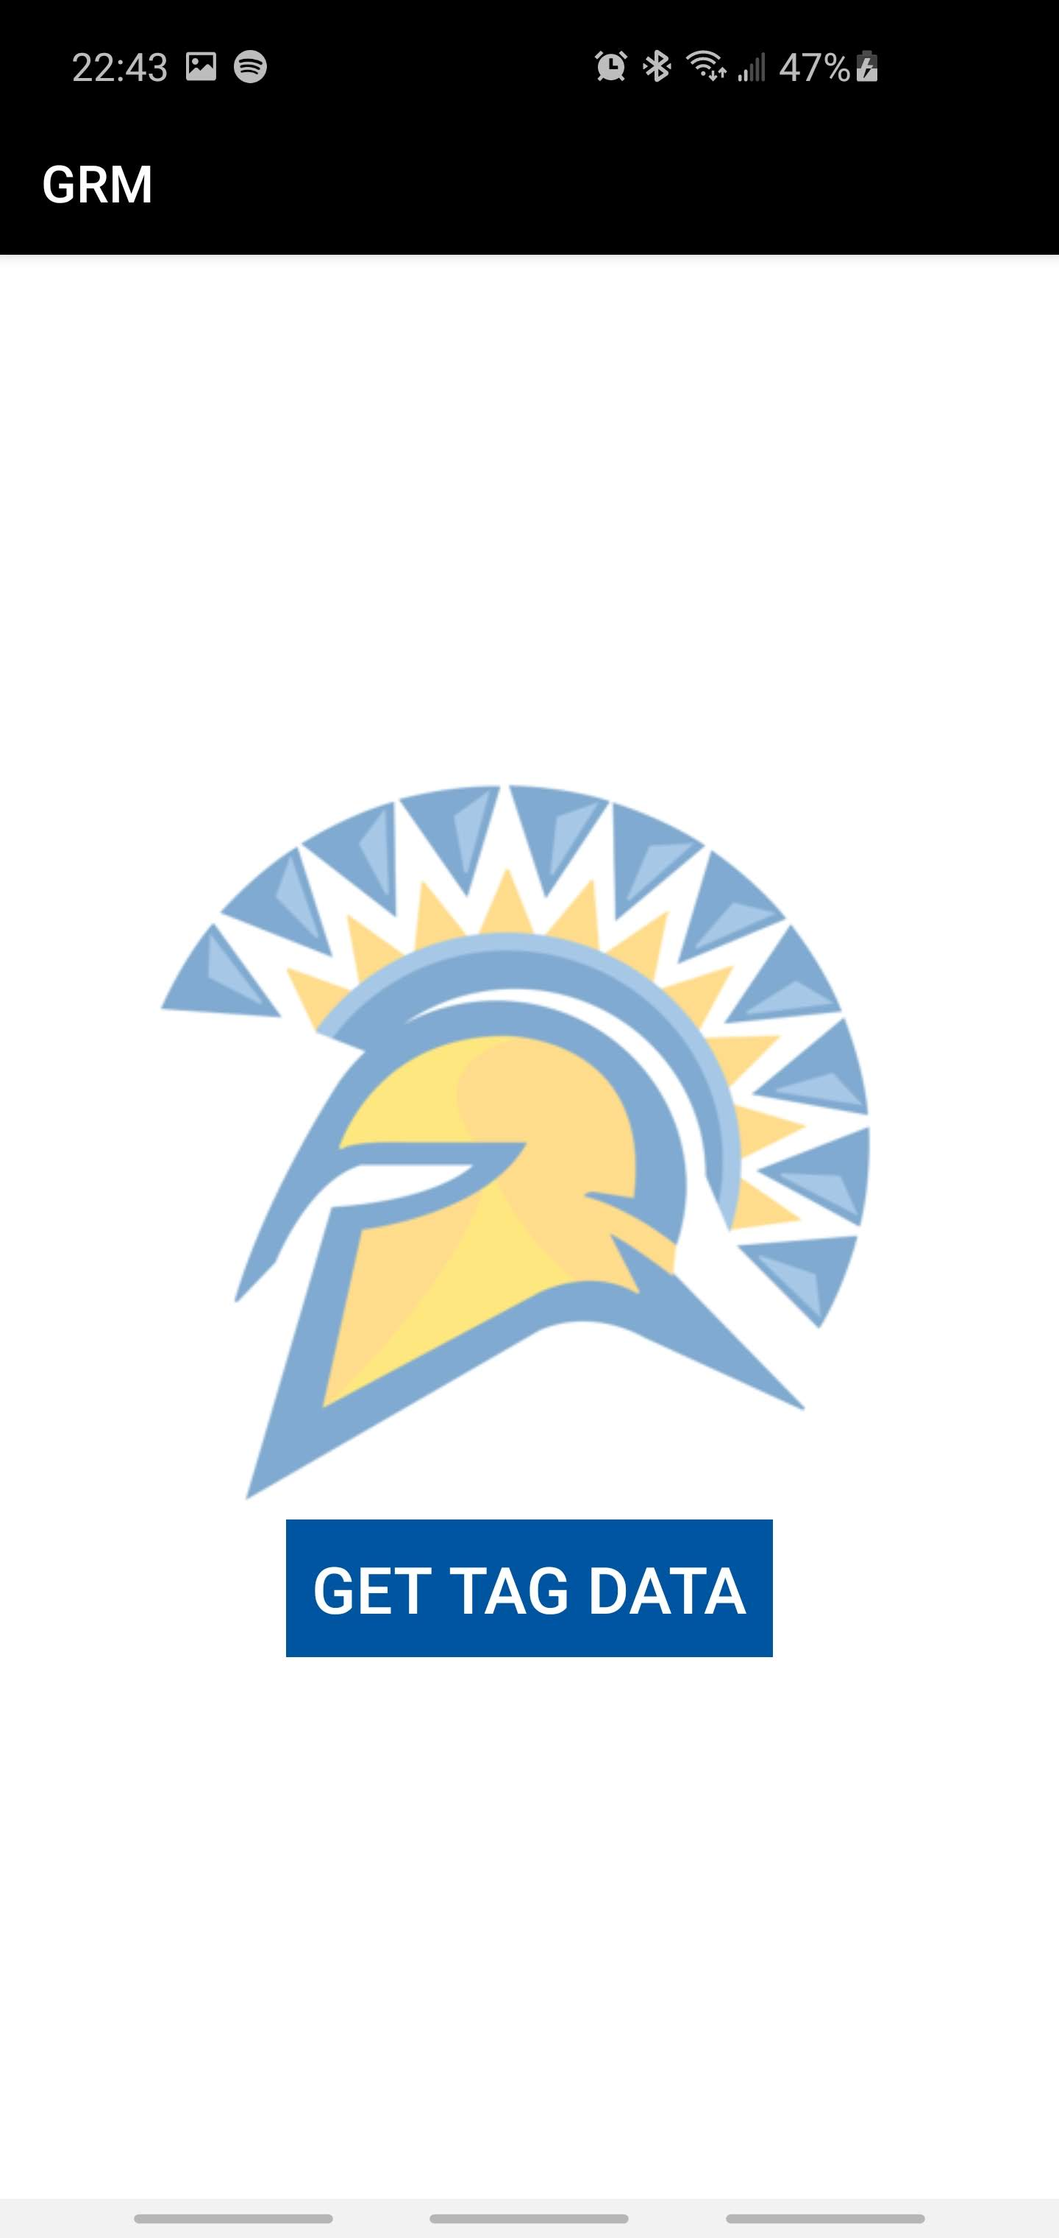
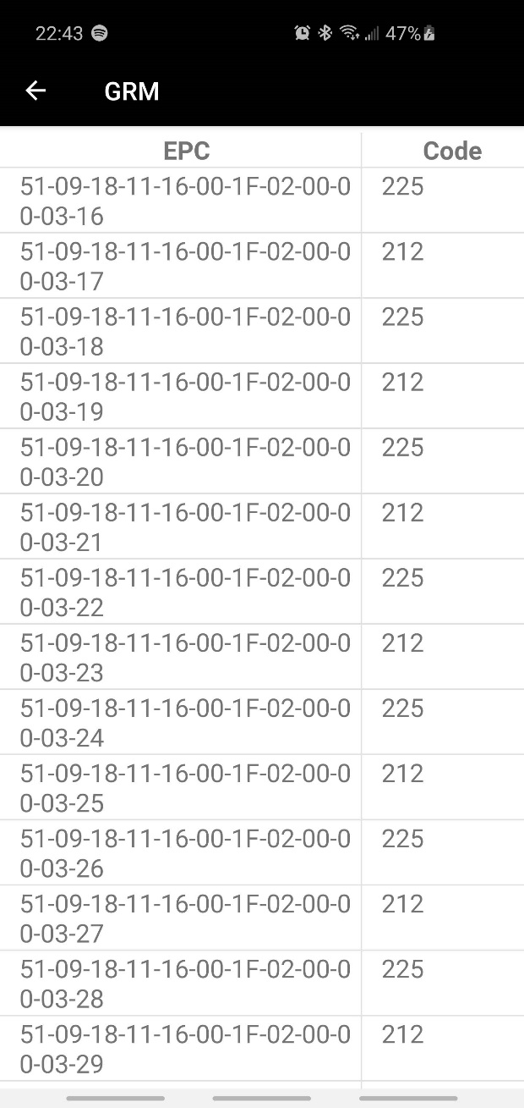
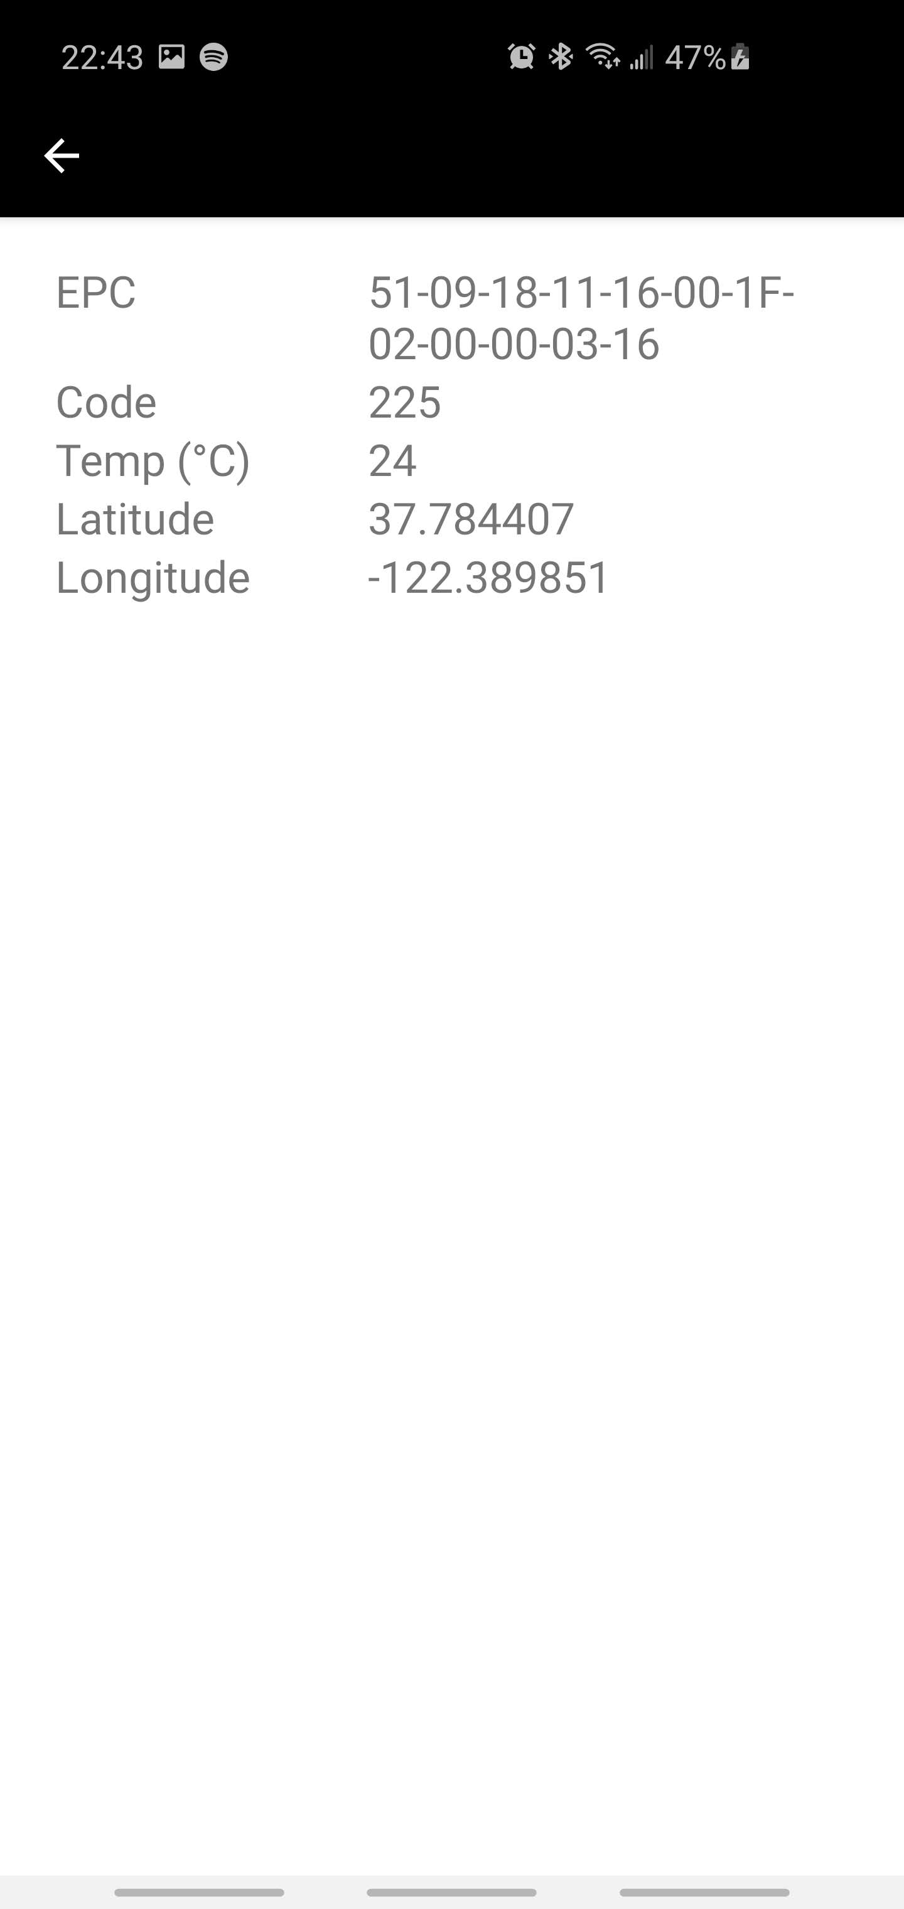
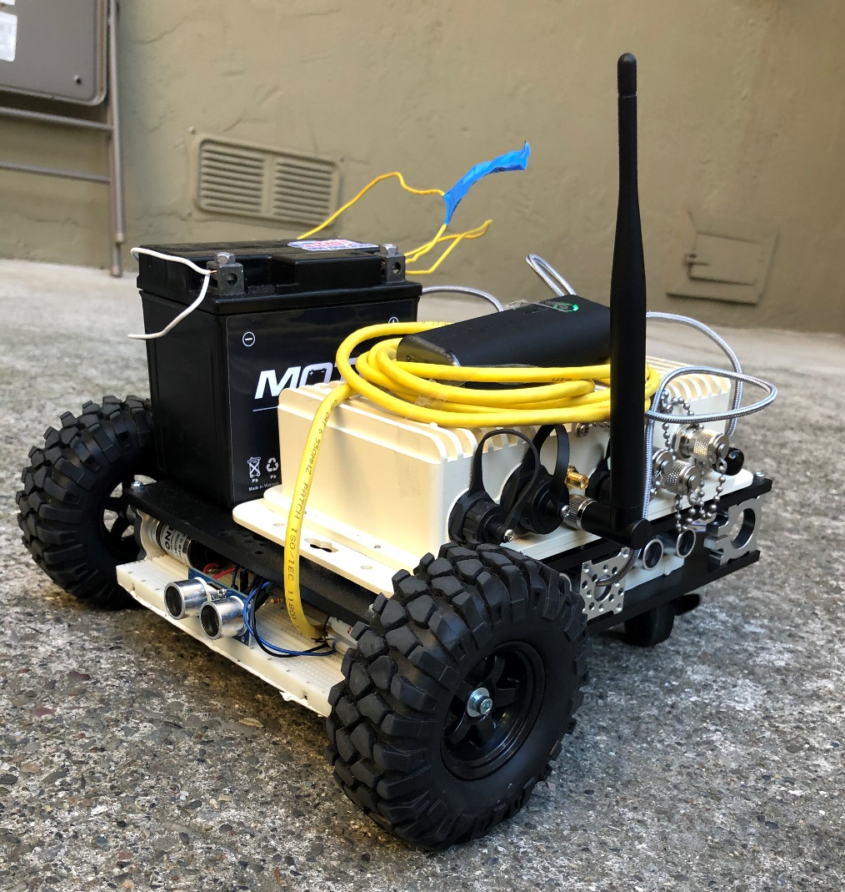
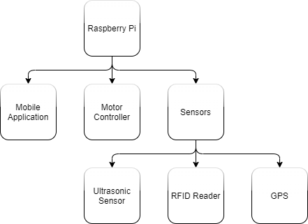
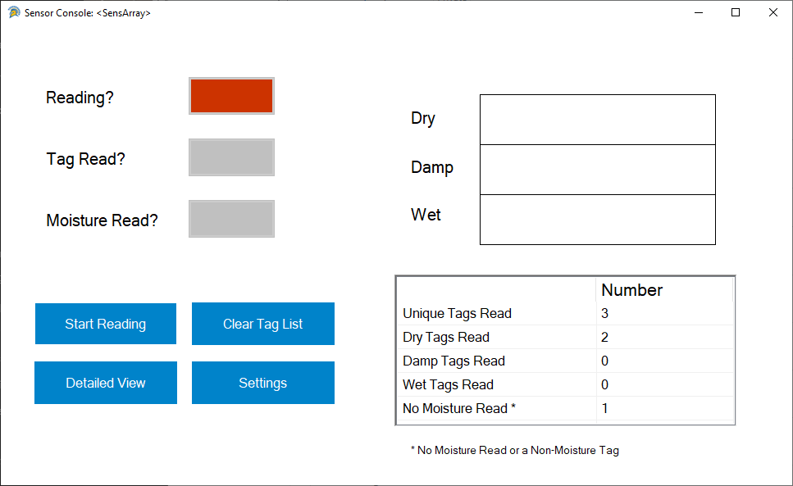
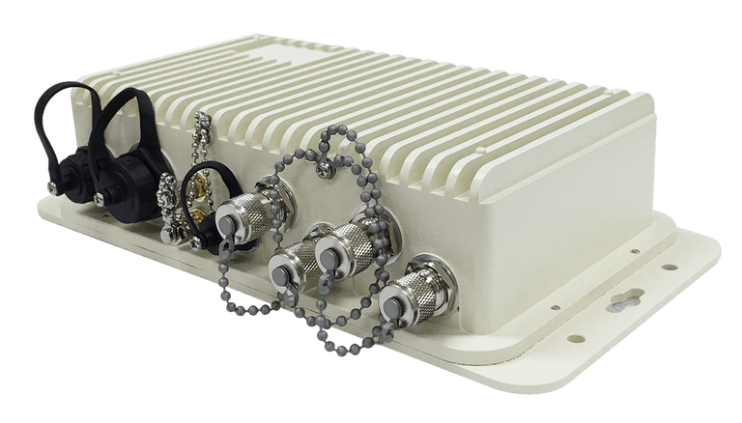
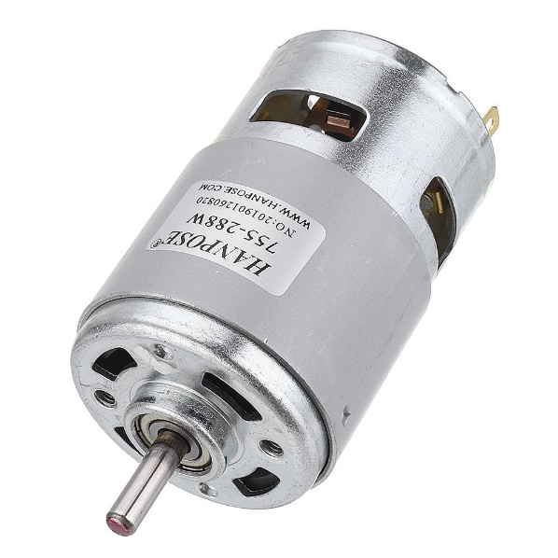
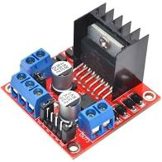
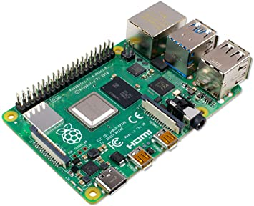
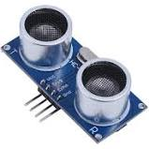
Computer Engineering Department
Project 19: GPS-Guided RFID Moisture Sensing Robot
Project Advisor: Donald Hung
Major, William (BS Computer Engineering) Tran, Austin (BS Computer Engineering)
Nazarian, Seri (BS Software Engineering)
Patel, Rohan (BS Software Engineering)
Introduction
Methodology
The second major portion was displaying tag data. This was handled in two different ways the GUI used an internally generated dictionary that stores all tag information and populates a table within the program. The mobile application is handed a CSV file upon completion of reading which it then parses and places within a table.
In order to also make this program more usable in professional applications a terminal program was designed that would perform the same actions as the GUI but simply output a CSV file that can be parsed and displayed by multiple applications
Summary/Conclusions
The project handles issues related to moisture buildup on industrial and
commercial building rooftops. Trapped moisture often damages these types of buildings and is extremely expensive for business owners to deal with. This is because industrial and commercial rooftops tend to be flat, unlike residential roofs, which are designed to have rain slip off onto the ground. The buildings our project is designed for are too wide, so creating an angled roof would be impractical and expensive due to the extra building material required.
Oftentimes, moisture isn’t detectable from the surface of the tile. Traditional methods of measuring this moisture require drilling into the tile, which obviously causes damage and potential for future problems. Additionally, multiple samples are required in order to accurately measure the moisture damage of a roof.
The main control program uses three major control structures.
The first is responsible for gathering GPS data from the RFID reader by shelling into the onboard Linux operating system and requesting GPS data passing it back to the main program allowing the robot to understand its current position.
The second is responsible for the motor controls used by the robot for navigation. The main thread is able to call this function which then delegates the request to the individual functions that allow for execution of the requested movement.
The third is responsible for gathering sensor data from the onboard ultrasound sensors which help the robot detect obstacles and when a wall is approaching.
Combined these threads are used to first define the outline of a roof then continually drive along the roof until it has been fully searched for wet roofing tiles
Every project will have some issues such as existing tools, lack of communication or issues that the team may have to deal with during the project life cycle . Our team learned that in order to be successful a team has to focus on every detail and they have to focus on the issues to solve and move forward with positivity and learn from past experience. Overall, this project gave us a very good sense of our responsibilities and tasks that we need to complete during a project life cycle. We learned that teamwork and communication and support is the key success to every project . Upon the completion of the project the team fulfilled almost all desired functionalities for the project. This project offered our team an enormous amount of learning curve in new programming skills and extensive research. Throughout this project, we as a team have cherished the ability to work on and design our own project in the hardware front as well as software, taking into account all the software and hardware design principles that we have learned in the duration of our time at SJSU. Combining knowledge from Mobile Application Development and Software and Computer Engineering classes, to incorporating principles from Interaction Design and Operating Systems, this project has enabled us to merge and implement the theories and concepts practiced in classes to produce a real-world product.
Some construction companies are implementing RFID-embedded tiles for rooftop construction. When these RFID tags are primed with an RF signal at a specific power level and frequency, the moisture level of the tile is returned. Our goal is to create an autonomous robot to navigate the rooftops of commercial and industrial buildings to map its moisture using these RFID tags. An extremely accurate moisture map can be produced and transmitted off-site to maintenance crews to repair damage before it becomes significant. Also, our method doesn’t require any damage to the rooftop, and hardly any interaction from people.
Key References
Analysis and Results
Artificial Intelligence for Engineering Design, Analysis and Manufacturing (2016), 30, 214–216. AKAO, Y. Quality Function Deployment: Integrating Customer Requirements into Product Design. Productivity Press, Cambridge, 1990. ALGER, J., AND HAYS, C. Creative Synthesis in Design. Prentice Hall, Englewood Cliffs, 1964. BIEGEL, P., AND PECHT, M. Design trade-offs made easy. Concurrent Engineering 1, 3 (May/June 1991), 29–40 COLTON, J., AND DESCANIO, J. An integrated, intelligent design environment. Engineering with Computers 7 (1991), 11–22. IEEE Standard for System, Software, and Hardware Verification and Validation," in IEEE Std 1012-2016 (Revision of IEEE Std 1012-2012/ Incorporates IEEE Std 1012-2016/Cor1-2017) , vol., no., pp.1-260, 29 Sept. 2017
Testing for the hardware portion of this project was very difficult because we were not able to go on to rooftops to test the robot completely, however the team was able to test each individual action that the robot needed to take to complete the task successfully
For rooftop navigation, we planned to bring the robot to the SJSU parking garage rooftop, and have the robot perform a perimeter sweep of the parking structure to construct a GPS boundary in which the robot will operate inside. After the GPS boundary is set, the robot will begin to navigate the rooftop in a “lawn-mower” path. However, with the current pandemic we were not allowed to use the SJSU garage for testing so we used the walls and steps to simulate different environments that the robot would have to navigate. The robot was able to successfully perform all the necessary tests needed to scan a roof.
There were two parts to the software testing. The first was to test the code designed to read RFID tags, which involved using RFID moisture tags and reading them when both dry and wet and ensuring that we the software was able to successfully determine between the two states. The software was able to successfully determine between the two tag states, however do to the nature of the moisture tags a fair amount of post processing was required to produce reliable results. The same testing was done on the terminal program, and yielded the same results. The second part was the mobile apps ability to take in data produced by the reader and display them in a readable and clear manner. Since this was a fairly basic portion of the project the testing was easily passed and.
    Software
Methodology
For this project the methodology is split between the hardware and software of the project
Hardware
For designing and programming the software solution the team had the same design principles as hardware with more emphasis on task delegation.
There were two major portions of the software solution. The first is communication between the program and the reader which uses TCP communication to send specific commands to the RFID reader which can then be processed by the software producing data that can then be displayed
Acknowledgements
For designing and programming the hardware solution the team kept two major design principles in mind. The first is to keep the code as simple as possible, and the second is to allow for delegation of tasks to multiple parts of the project all running in unison using multithreading.
Our Group would like to acknowledge SensThys for providing all of the RFID equipment used in this project on loan free of charge

